Slide 1
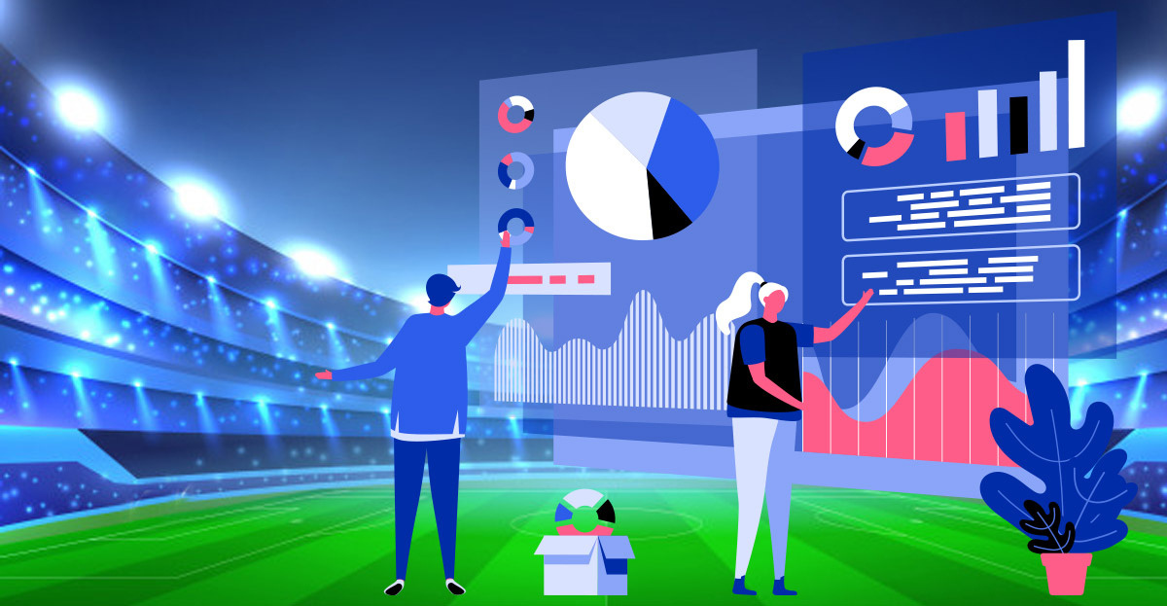
Cricket Analysis

Slide 2
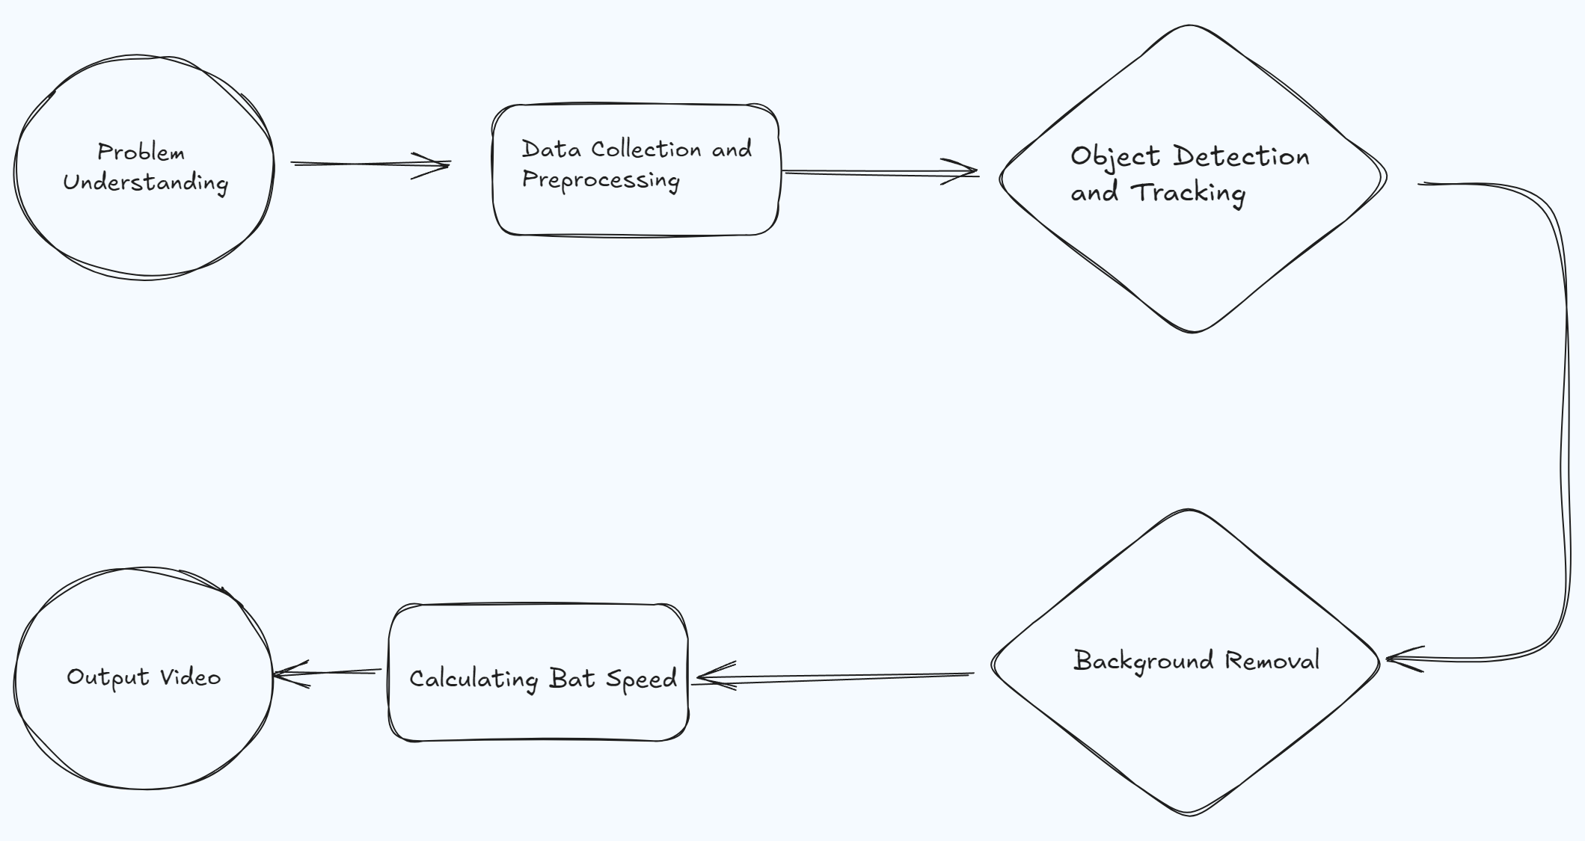
Pipeline

Slide 3
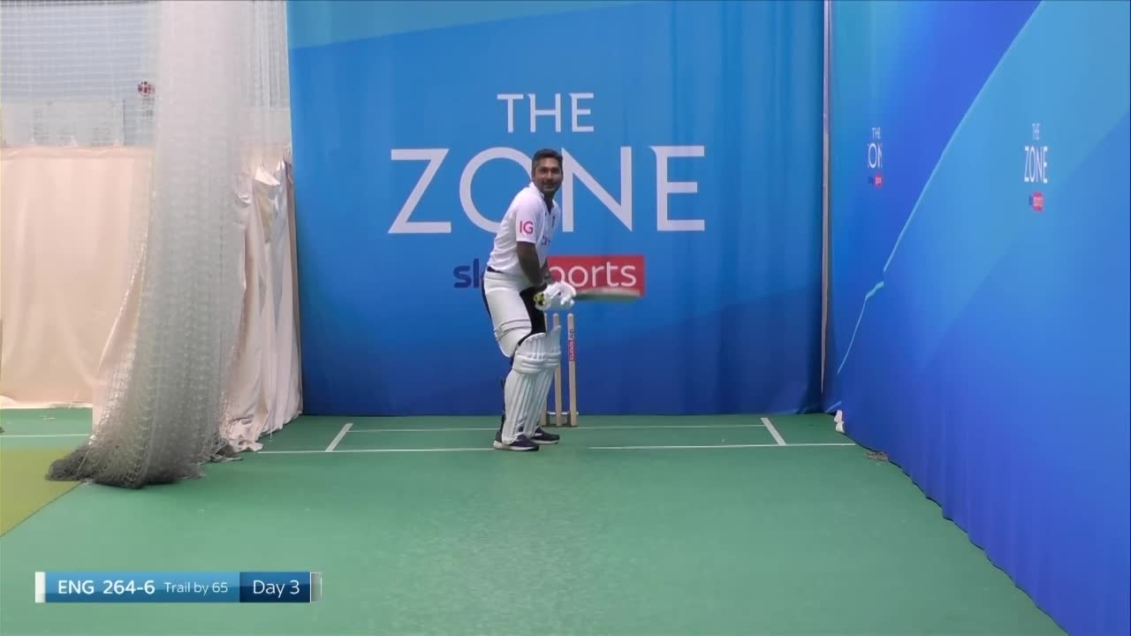
Original Clip

Slide 4
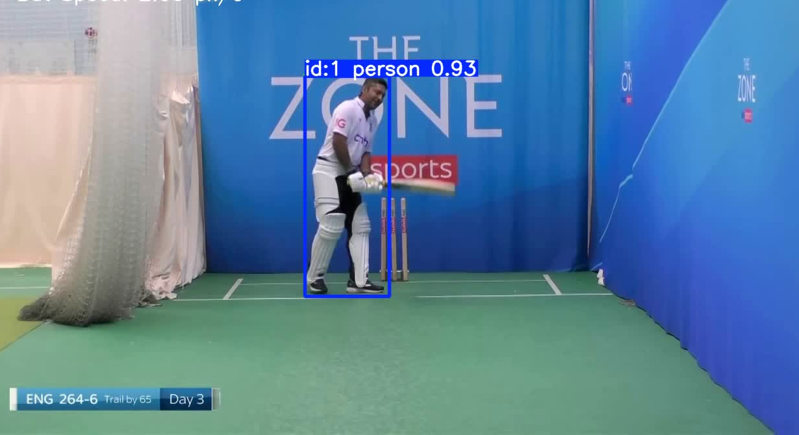
Detection of objects with roboflow datset training

Slide 5
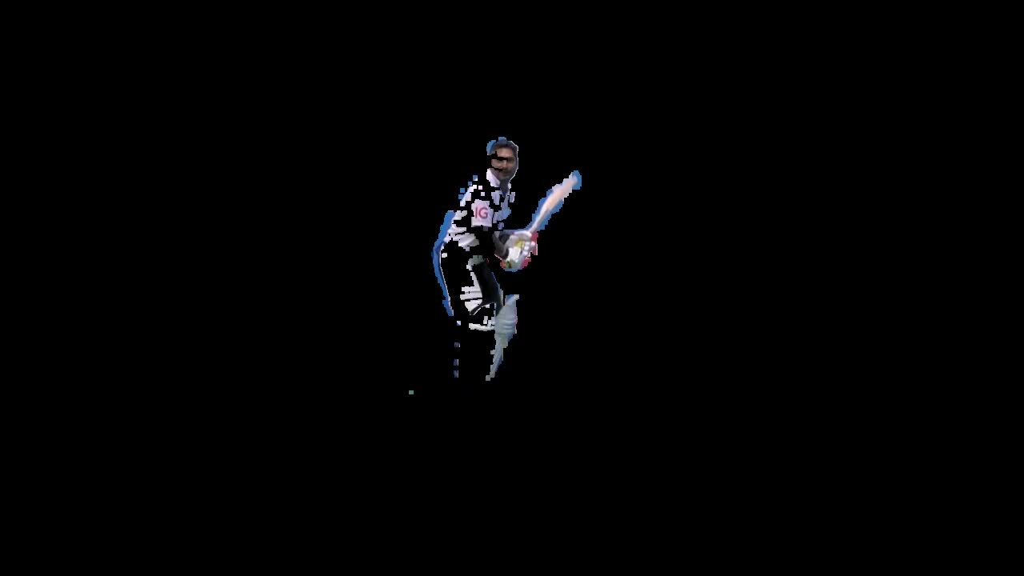
Foreground Output

Slide 6
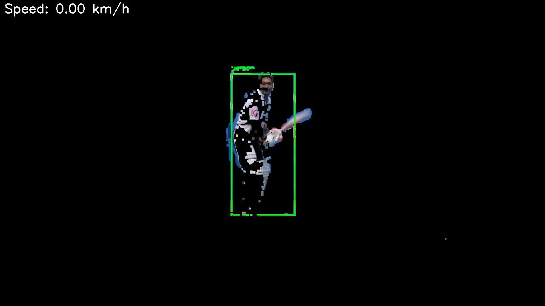
Background Segmentation with detetction

Slide 7
Thank You

